Slide 1


Sanjivani College of Engineering, Kopargaon
Department of Electronics & Computer Engineering
(An Autonomous Institute)
Affiliated to Savitribai Phule Pune University
Accredited ‘A’ Grade by NAAC ____________________________________________________________________
Unit 1
Analog Circuits
Introduction to Analog circuits
By
Dr. D. G. Lokhande
Assistant Professor
Faculty, Department of ECE Engg.

Slide 2
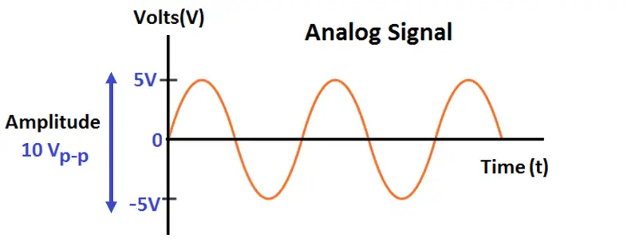
Analog Signal
An analog signal is a voltage, current, or physical quantity that continuously and infinitely varies in accordance with some time-varying parameter.
An analog signals are varying from zero volts to any infinite amplitude with respective to time.
Prof. D. G. Lokhande Department of E & Tc Engg.

Slide 3
Analog Circuits
An analog circuit is a type electronic circuit that can process any analog signal or data and produce an output in analog form. Analog circuits are composed of resistors, inductors and capacitors, etc. The type of signal which is a continuous function of time is known as an analog signal.
Prof. D. G. Lokhande Department of E & Tc Engg.

Slide 4
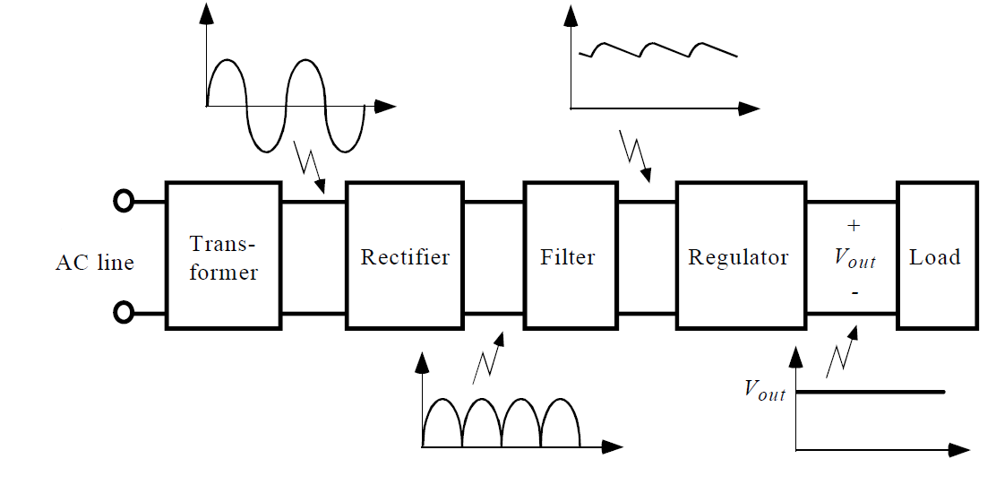
Basic Block Diagram of Regulated power Supply
Prof. D. G. Lokhande Department of E & Tc Engg.

Slide 5
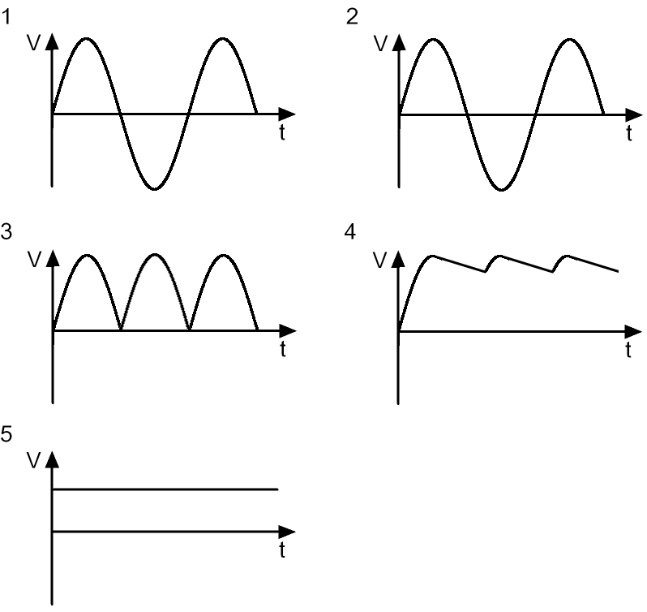
Wave forms at various points in a Regulated power supply
Prof. D. G. Lokhande Department of E & Tc Engg.

Slide 6
• Transformer ;steps down high voltage AC mains to low voltage AC.
• Rectifier: converts AC to DC, but the DC output is varying
• Filter: smooth the DC from varying greatly to a small ripple.
• Regulator : eliminates ripple by setting DC output to a fixed voltage
Prof. D. G. Lokhande Department of E & Tc Engg.

Slide 7
Rectification
Rectification is a process of converting the alternating quantity (voltage or current) into a corresponding direct quantity(voltage or current).
The input to a rectifier is AC whereas its output is unidirectional or DC.
Prof. D. G. Lokhande Department of E & Tc Engg.

Slide 8
Rectifiers
Rectifier is an electronic device which is used for converting an alternating quantity (Voltage or current) into unidirectional i.e. DC quantity (Voltage or current).
Block diagram of Rectifier:
Prof. D. G. Lokhande Department of E & Tc Engg.

Slide 9
Need of Rectification
Every electronic circuit such as amplifiers, needs a DC power source for its operation.
This DC voltage has to be obtained from AC supply.
For this the AC supply has to be reduced Stepped down first using a Step down transformer and then converted to dc by using rectifier.
Prof. D. G. Lokhande Department of E & Tc Engg.

Slide 10
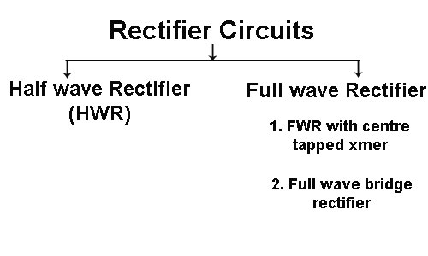
Types of Rectifier
Prof. D. G. Lokhande Department of E & Tc Engg.

Slide 11
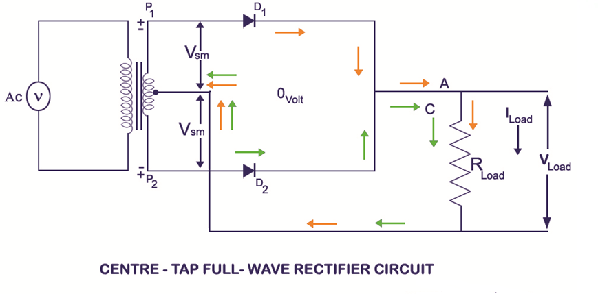
Full Wave Rectifier (Center Tapped Transformer)
Prof. D. G. Lokhande Department of E & Tc Engg.

Slide 12
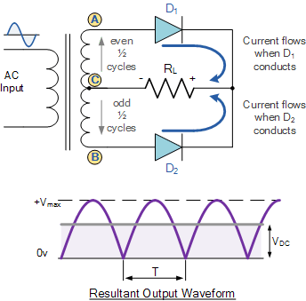
Prof. D. G. Lokhande Department of E & Tc Engg.

Slide 13
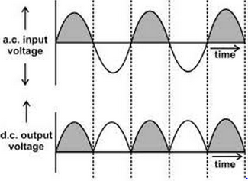
Prof. D. G. Lokhande Department of E & Tc Engg.

Slide 14
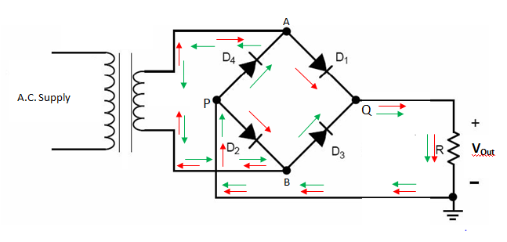
Full Wave Rectifier (Bridge)
Prof. D. G. Lokhande Department of E & Tc Engg.

Slide 15
Prof. D. G. Lokhande Department of E & Tc Engg.

Slide 16
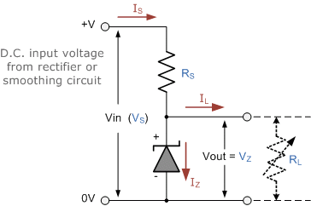
Zener Diode as Regulator
Prof. D. G. Lokhande Department of E & Tc Engg.

Slide 17
In the forward-biased direction, that is Anode is more positive with respect to its Cathode, a zener diode behaves like a normal junction diode when the forward voltage V_{F} across the diode exceeds 0.7 volts (silicon) causing the zener diode to conduct. The forward current flowing through the conducting diode is at its maximum determined only by the connected load. Thus in the forward-bias direction, the zener behaves like a regular diode within its specified current and/or power limits and as such, the forward characteristics of a zener diode is generally of no interest.
However, unlike a conventional diode that blocks any flow of current through itself when reverse biased, that is the Cathode becomes more positive than the Anode, as soon as the reverse voltage reaches a pre-determined value, the zener diode begins to conduct in the reverse direction.
Since a zener diode is designed to work in the reverse breakdown region of its characteristic curve, they have a fixed breakdown voltage, V_{Z} value which is determined during manufacture. As the reverse voltage across the zener diode increases from 0 volts to its zener breakdown voltage, a small reverse or leakage current will flow through the diode which remains fairly constant as the reverse voltage increases.
Prof. D. G. Lokhande Department of E & Tc Engg.

Slide 18
Once the reverse voltage applied across the zener diode exceeds the rated voltage of the device, a process called Zener Breakdown occurs in the semiconductor depletion layer and a current starts to flow through the diode to limit this increase in voltage.
The current now flowing through the zener diode increases dramatically to its maximum circuit value (which is usually limited by a series resistor). Once zener breakdown occurs, the voltage drop across the diode remains fairly constant even though the zener current, I_{Z} through it can vary considerably. The voltage point at which the voltage across the zener diode becomes stable is called the “zener voltage”, (V_{Z}). For zener diodes this breakdown voltage value can range from a few volts upto a few hundred volts.
The point at which the zener voltage triggers the current to flow through the diode can be very accurately controlled (to less than 1% tolerance) in the doping stage of the diodes semiconductor construction giving the diode a specific zener breakdown voltage, ( V_{Z} ) for example, 4.3V or 7.5V. This zener breakdown voltage on the I-V curve is almost a vertical straight line.
Prof. D. G. Lokhande Department of E & Tc Engg.

Slide 19
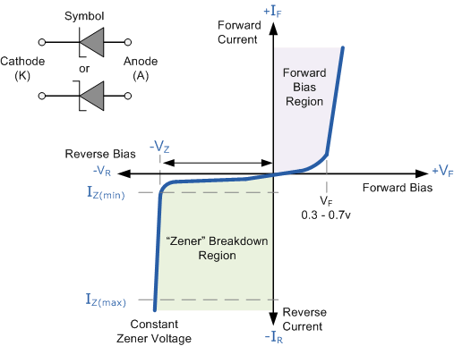
Zener Diode I-V Characteristics
Prof. D. G. Lokhande Department of E & Tc Engg.

Slide 20
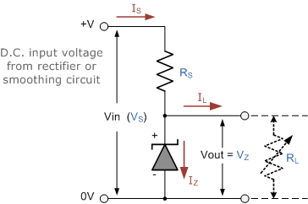
The Zener Diode Regulator
Zener Diodes can be used to produce a stabilised voltage output with low ripple under varying load current conditions. By passing a small current through the diode from a voltage source, via a suitable current limiting resistor (R_{S}), the zener diode will conduct sufficient current to maintain a voltage drop of Vout.
We remember from the previous tutorials that the DC output voltage from the half or full-wave rectifiers contains ripple superimposed onto the DC voltage and that as the load value changes so to does the average output voltage. By connecting a simple zener stabiliser circuit as shown below across the output of the rectifier, a more stable output voltage can be produced.
Zener Diode Regulator
Prof. D. G. Lokhande Department of E & Tc Engg.

Slide 21
IC Regulators
Voltage regulator: is a circuit that supplies constant voltage regardless of changes in the load current.
✶ Advantages of IC voltage regulator: inexpensive, versatile, provides current /voltage boosting, internal short circuit current limiting, thermal shutdown, floating operation for high voltage applications.
Classification of IC voltage regulators:
✶ There are basically two kinds of IC voltage regulators:
3-pin type, e.g. 78/79XX
Multi-pin type, e.g. LM723C
3-pin types make regulator circuit design simple
Multi-pin regulators are less popular but they provide the greatest flexibility and produce the highest quality voltage regulation
Prof. D. G. Lokhande Department of E & Tc Engg.

Slide 22
IC Regulators
Types of IC regulators
IC regulators can be of the following types −
Fixed Positive voltage regulators
Fixed Negative voltage regulators
Adjustable voltage regulators
Dual-tracking voltage regulators
Let us now discuss them in detail.
Fixed Positive Voltage Regulator
The output of these regulators is fixed to a specific value and the values are positive, which means the output voltage provided is positive voltage.
The most used series is 7800 series and the ICs will be like IC 7806, IC 7812 and IC 7815 etc. which provide +6v, +12v and +15v respectively as output voltages. The figure below shows the IC 7810 connected to provide a fixed 10v positive regulated output voltage.
Prof. D. G. Lokhande Department of E & Tc Engg.

Slide 23
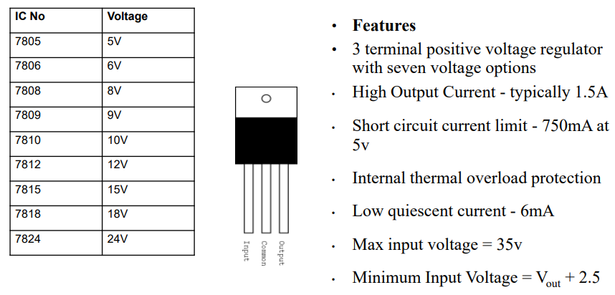
78XX Basic Features
Prof. D. G. Lokhande Department of E & Tc Engg.

Slide 24
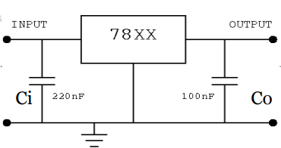
FIXED VOLTAGE POSITIVE REGULATOR
a)positive voltage regulator
 The 78XX voltage regulators
 Fig shows the connection diagram of 78XX series
 Proper operation requires a common ground between the input and output voltages.
 The difference between the input and output voltages(Vin- Vout) called dropout voltage must be 2V even during low point in the input ripple voltage.
 Capacitor Ci , is required if the regulator is located an appreciable distance from a power supply filter. Even though Co is not required, it may be used to improve the transient response of the regulator.
In the above figure, the input capacitor Ci is used to prevent unwanted oscillations and the output capacitor Co acts as a line filter to improve transient response.
Prof. D. G. Lokhande Department of E & Tc Engg.

Slide 25
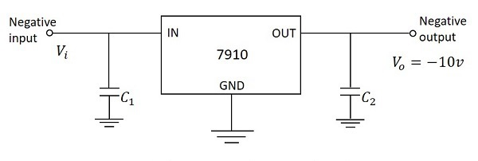
Fixed Negative Voltage Regulator
The output of these regulators is fixed to a specific value and the values are negative, which means the output voltage provided is negative voltage.
The most used series is 7900 series and the ICs will be like IC 7906, IC 7912 and IC 7915 etc. which provide -6v, -12v and -15v respectively as output voltages. The figure below shows the IC 7910 connected to provide a fixed 10v negative regulated output voltage.
In the above figure, the input capacitor C1 is used to prevent unwanted oscillations and the output capacitor C2 acts as a line filter to improve transient response.
Prof. D. G. Lokhande Department of E & Tc Engg.

Slide 26
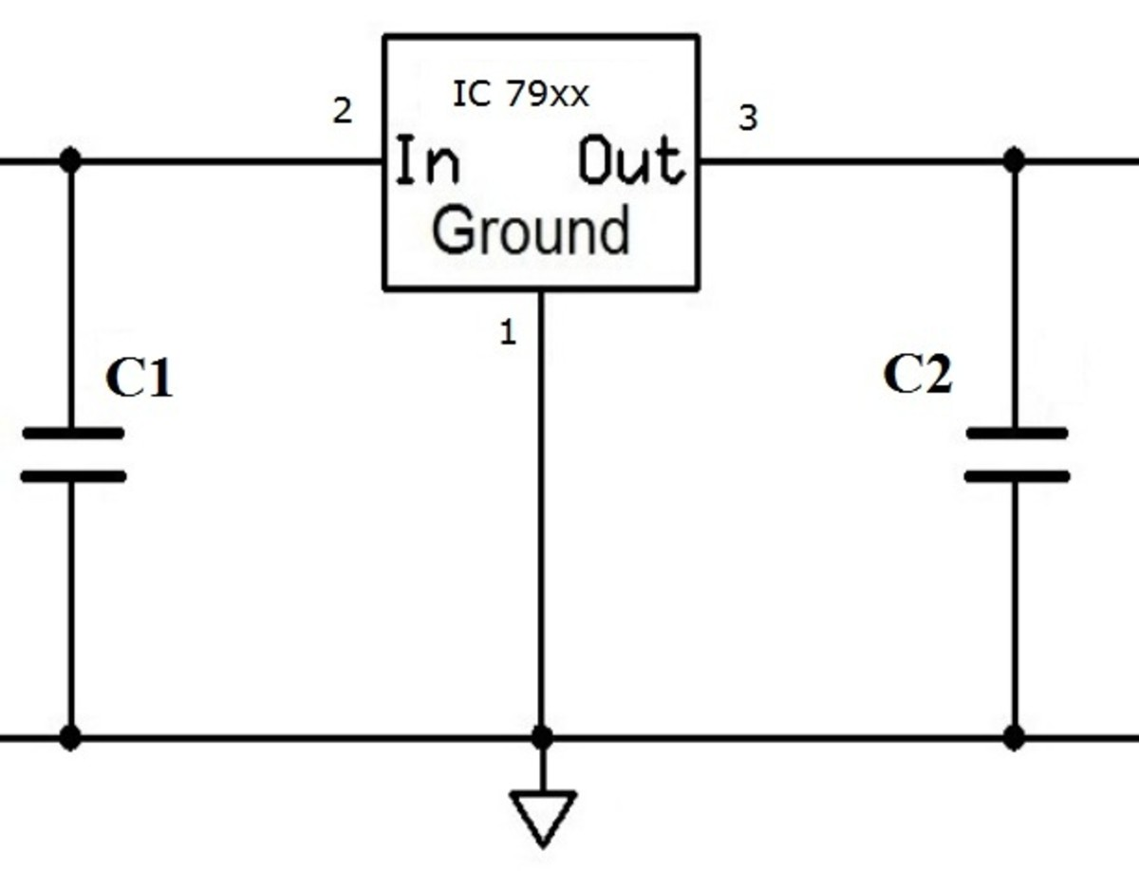
Negative voltage regulator IC's are available in 79XX series. • These IC's are similar to the 78 series, but operating on negative voltage, and providing a regulated negative output voltage. • The capacitors connected at the input and output sides are used to provide additional filter circuits of regulator circuits.
IC 79xx is used in circuits as shown in the circuit above. In order to improve stability, two capacitors—C₁ and C₂—are used.
The capacitor C₁ is used only if the regulator is separated from filter capacitor by more than 3". It must be a 2.2 μF solid tantalum capacitor or 25μF aluminum electrolytic capacitor.
The capacitor C₂ is required for stability. Usually a 1 μF solid tantalum capacitor is used. One can also use a 25μF aluminum electrolytic capacitor. Values given may be increased without limit.
Prof. D. G. Lokhande Department of E & Tc Engg.

Slide 27
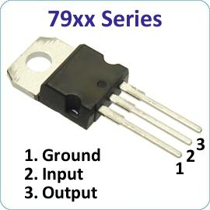
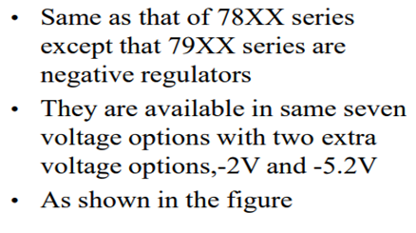
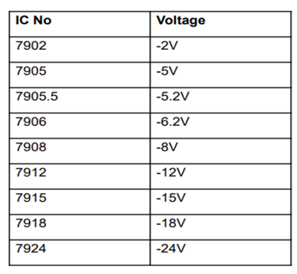
Prof. D. G. Lokhande Department of E & Tc Engg.

Slide 28
What is a Bipolar Junction Transistor (BJT)?
A bipolar junction transistor is a three-terminal semiconductor device that consists of two p-n junctions which are able to amplify or magnify a signal. It is a current controlled device. The three terminals of the BJT are the base, the collector and the emitter. A signal of small amplitude applied to the base is available in the amplified form at the collector of the transistor. This is the amplification provided by the BJT. Note that it does require an external source of DC power supply to carry out the amplification process. Bipolar transistors are manufactured in two types, PNP and NPN, and are available as separate components, usually in large quantities. The prime use or function of this type of transistor is to amplify current. This makes them useful as switches or amplifiers. They have a wide application in electronic devices like mobile phones, televisions, radio transmitters and industrial control..
Prof. D. G. Lokhande Department of E & Tc Engg.

Slide 29
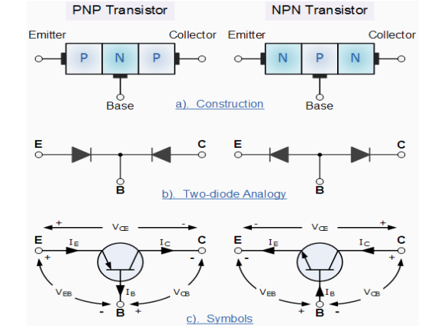
Prof. D. G. Lokhande Department of E & Tc Engg.

Slide 30
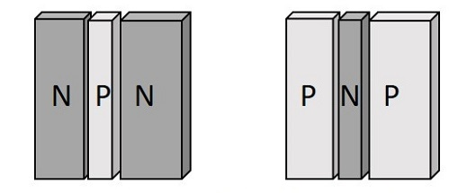
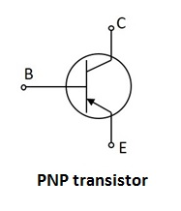
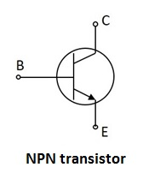
Constructional Details of a Transistor
The Transistor is a three terminal solid state device which is formed by connecting two diodes back to back. Hence it has got two PN junctions. Three terminals are drawn out of the three semiconductor materials present in it. This type of connection offers two types of transistors. They are PNP and NPN which means an N-type material between two P-types and the other is a P-type material between two N-types respectively.
The following illustration shows the basic construction of transistors
Prof. D. G. Lokhande Department of E & Tc Engg.

Slide 31
The three terminals drawn from the transistor indicate Emitter, Base and Collector terminals. They have their functionality as discussed below.
Emitter
The left-hand side of the above shown structure can be understood as Emitter. This has a moderate size and is heavily doped as its main function is to supply a number of majority carriers, i.e. either electrons or holes. As this emits electrons, it is called as an Emitter. This is simply indicated with the letter E.
Base
The middle material in the above figure is the Base. This is thin and lightly doped. Its main function is to pass the majority carriers from the emitter to the collector. This is indicated by the letter B.
Collector
The right side material in the above figure can be understood as a Collector. Its name implies its function of collecting the carriers. This is a bit larger in size than emitter and base. It is moderately doped. This is indicated by the letter C.
Prof. D. G. Lokhande Department of E & Tc Engg.

Slide 32
If the circuit uses the Bipolar Transistor as a Switch, then the biasing of the transistor, either NPN or PNP is arranged to operate the transistor at both sides of the ” I-V ” characteristics curves we have seen previously.
The areas of operation for a transistor switch are known as the Saturation Region and the Cut-off Region. This means then that we can ignore the operating Q-point biasing and voltage divider circuitry required for amplification, and use the transistor as a switch by driving it back and forth between its “fully-OFF” (cut-off) and “fully-ON” (saturation) regions as shown below.
Prof. D. G. Lokhande Department of E & Tc Engg.

Slide 33
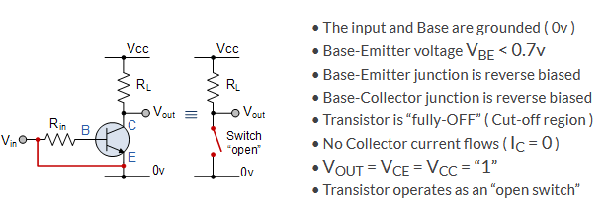
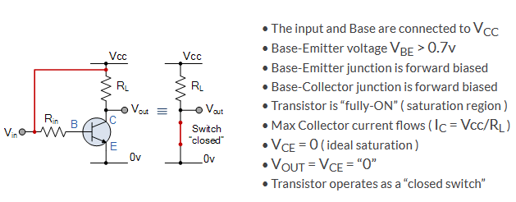
Cut-off region Condition
Saturation region Condition
Prof. D. G. Lokhande Department of E & Tc Engg.

Slide 34
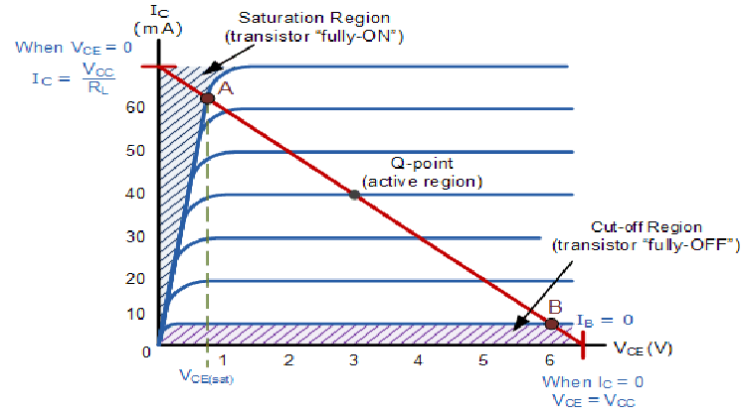
Prof. D. G. Lokhande Department of E & Tc Engg.

Slide 35
Transistor as Amplifier
Transistor as a Amplifier Transistors are can be configured in three different ways depending on whether the common terminal b/w the input and output ports is base, collector or emitter and are named common base(CB), common collector(CC) and common emitter(CE), accordingly.
These can be used as switches or amplifiers based on the choice of OPERATING POINT AND REGION OF OPERATION .For switching the transistor circuits when made to operate between cut-off and saturation regions and for amplifiers when made to operate in their active region. In addition, it is to be kept in mind that the transistors are inherently nothing but the current-controlled devices wherein a small change in the base current, IB results in a large variation in the collector current, IC such that (IE=IB+IC) .
Figure shows a simple common emitter circuit which uses an npn transistor whose
• Collector terminal (output terminal) is connected to supply voltage VCC through the collector resistor RC.
• Base terminal is provided with the AC signal which needs to be amplified.
• Emitter terminal is grounded (hence also referred to as Grounded Emitter configuration).
Prof. D. G. Lokhande Department of E & Tc Engg.

Slide 36
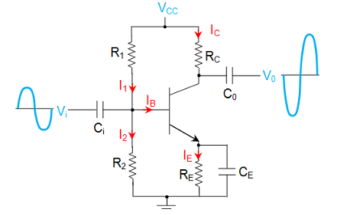
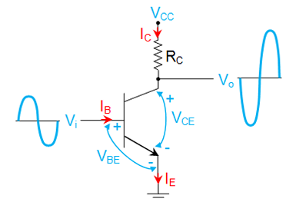

For 1st half of input signal, as the input voltage Vi increases, the base current IB also increases which in turn increases the collector current IC. This causes an increase in the voltage drop across the collector resistor, RC which results in a decreased output voltage V0 as emphasized by the following relationship
Thus for the positive half-cycle of the input waveform, one would get amplified negative half-cycle while for the negative input signal, the output would be a amplified positive pulse. Hence there exists a phase-shift of 180o between the input and the output waveforms of the common emitter amplifier (also called as inverting amplifier).
Prof. D. G. Lokhande Department of E & Tc Engg.

Slide 37
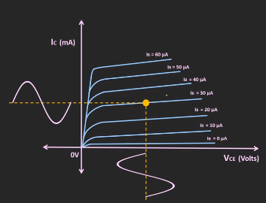
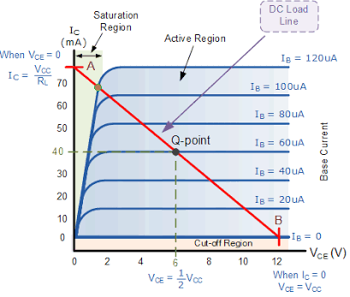
Prof. D. G. Lokhande Department of E & Tc Engg.

Slide 38
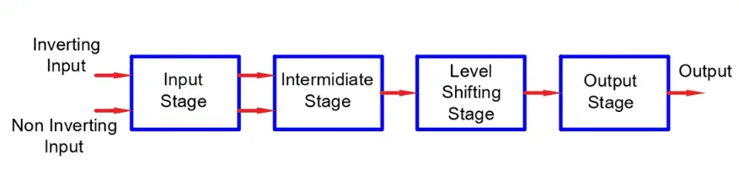
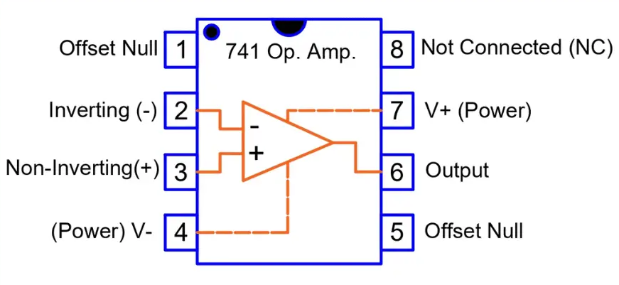
OPAMP
Block diagram of Operational Amplifier (OPAMP)
Pin configuration of Operational Amplifier (OPAMP)
Prof. D. G. Lokhande Department of E & Tc Engg.

Slide 39
An operational amplifier or op amp is a DC coupled voltage amplifier with a very high voltage gain
Op amp is basically a multistage amplifier in which a number of amplifier stages are interconnected to each other in a very complicated manner. Its internal circuit consists of many transistors, FETs and resistors. All this occupies a very little space. So, it is packed in a small package and is available in the Integrated Circuit (IC) form. The term Op Amp is used to denote an amplifier which can be configured to perform various operations like amplification, subtraction, differentiation, addition, integration etc. An example is the very popular IC 741.
An operational amplifier, or op-amp, is a very high gain differential amplifier with high input impedance and low output impedance. Typical uses of the operational amplifier are to provide voltage amplitude changes (amplitude and polarity), oscillators, filter circuits, and many types of instrumentation circuits. An op-amp contains a number of differential amplifier stages to achieve a very high voltage gain. Figure given below shows a basic op-amp with two inputs and one output as would result using a differential amplifier input stage. We call the terminal, marked with negative (-) sign as the inverting terminal and the terminal marked with positive (+) sign as the non-inverting terminal of the operational amplifier. If we apply an input signal at the inverting terminal (-) than the amplified output signal is 180o out of phase concerning the applied input signal. If we apply an input signal to the non inverting terminal (+) then the output signal obtained will be in phase, i.e It will have no phase shift with respect to input signal. The op-amp also has two voltage supply terminals
Prof. D. G. Lokhande Department of E & Tc Engg.

Slide 40
CHARACTERISTICS OF AN OP-AMP
Characteristics | Ideal | Practical
CMRR | Infinite | 120 dB
Slew Rate | Infinite | 80 V/ms
Input Resistance | Infinite | 10⁶ W
Output Resistance | Zero | 100 W
Gain | Infinite | 10⁶
Bandwidth | Infinite | 10⁶ Hz
Offset Voltage | Zero | Negligible
Offset Current | Zero | Approx. In nA
Prof. D. G. Lokhande Department of E & Tc Engg.

Slide 41
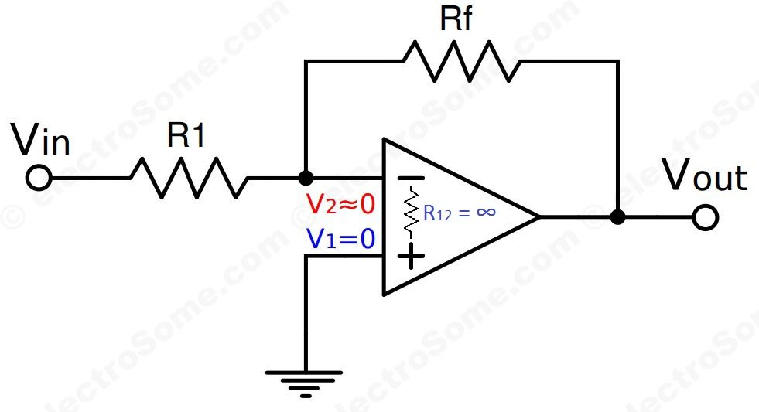
What is Virtual Ground ?
As the name indicates it is virtual, not real ground. For some purposes we can consider it as equivalent to ground. In opamps the term virtual ground means that the voltage at that particular node is almost equal to ground voltage (0V). It is not physically connected to ground. This concept is very useful in analysis of opamp circuits and it will make a lot of calculations very simple.
Virtual Ground –
Lets see how the virtual ground concept is employed in inverting amplier.
Gain = Vo/Vin
As gain is infinite, Vin = 0
Vin = V2 – V1
In the above circuit V1 is connected to ground, so V1 = 0. Thus V2 also will be at ground potential.
V2 = 0
Prof. D. G. Lokhande Department of E & Tc Engg.

Slide 42
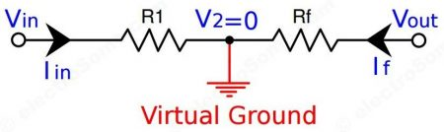
Using Infinite Voltage Gain
We already know that an ideal opamp will provide infinite voltage gain. For real opamps also the gain will be very high such that we can consider it as infinite for calculation purposes.
Why we need Virtual Ground ?
Virtual Ground concept is very useful in analysis of an opamp when negative feedback is employed. It will simply a lot of calculations and derivations.
Prof. D. G. Lokhande Department of E & Tc Engg.

Slide 43
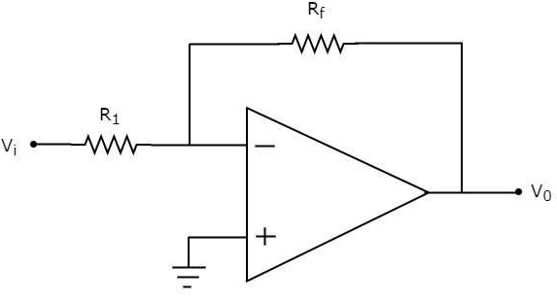
Inverting Amplifier
An inverting amplifier takes the input through its inverting terminal through a resistor R1, and produces its amplified version as the output. This amplifier not only amplifies the input but also inverts it (changes its sign).
The circuit diagram of an inverting amplifier is shown in the following figure −
Note that for an op-amp, the voltage at the inverting input terminal is equal to the voltage at its non-inverting input terminal. Physically, there is no short between those two terminals but virtually, they are in short with each other.
In the circuit shown above, the non-inverting input terminal is connected to ground. That means zero volts is applied at the non-inverting input terminal of the op-amp.
According to the virtual short concept, the voltage at the inverting input terminal of an op-amp will be zero volts.
The nodal equation at this terminal's node is as shown below −
Prof. D. G. Lokhande Department of E & Tc Engg.

Slide 44
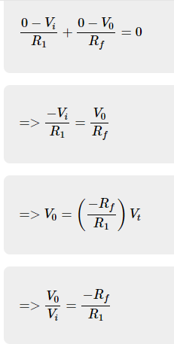
Note that the gain of the inverting amplifier is having a negative sign. It indicates that there exists a 180⁰ phase difference between the input and the output.
Prof. D. G. Lokhande Department of E & Tc Engg.

Slide 45
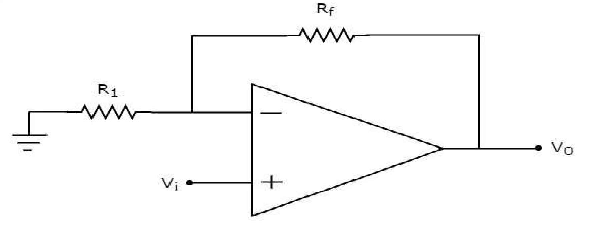
Non-Inverting Amplifier
A non-inverting amplifier takes the input through its non-inverting terminal, and produces its amplified version as the output. As the name suggests, this amplifier just amplifies the input, without inverting or changing the sign of the output.
The circuit diagram of a non-inverting amplifier is shown in the following figure −
In the above circuit, the input voltage Vi�� is directly applied to the non-inverting input terminal of op-amp. So, the voltage at the non-inverting input terminal of the op-amp will be Vi��.
By using voltage division principle, we can calculate the voltage at the inverting input terminal of the op-amp as shown below −
Prof. D. G. Lokhande Department of E & Tc Engg.

Slide 46
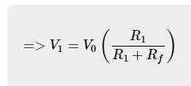
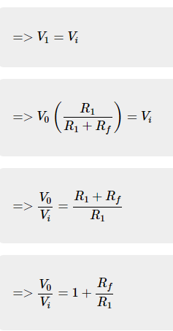
According to the virtual short concept, the voltage at the inverting input terminal of an op-amp is same as that of the voltage at its non-inverting input terminal.
Prof. D. G. Lokhande Department of E & Tc Engg.

Slide 47

Now, the ratio of output voltage V0 and input voltage Vi or the voltage-gain or gain of the non-inverting amplifier is equal to
Note that the gain of the non-inverting amplifier is having a positive sign. It indicates that there is no phase difference between the input and the output.
Prof. D. G. Lokhande Department of E & Tc Engg.

Slide 48
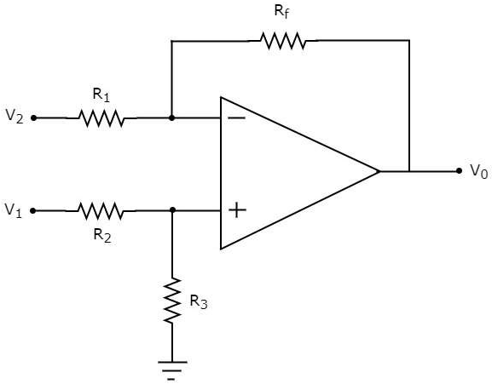
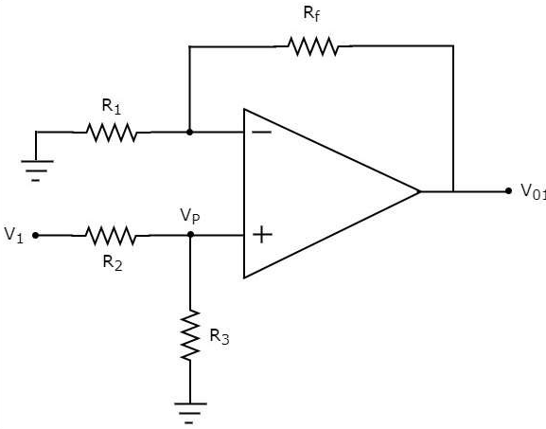
Subtractor
A subtractor is an electronic circuit that produces an output, which is equal to the difference of the applied inputs. This section discusses about the op-amp based subtractor circuit.
An op-amp based subtractor produces an output equal to the difference of the input voltages applied at its inverting and non-inverting terminals. It is also called as a difference amplifier, since the output is an amplified one.
The circuit diagram of an op-amp based subtractor is shown in the following figure −
Prof. D. G. Lokhande Department of E & Tc Engg.

Slide 49
Now, let us find the expression for output voltage V0 of the above circuit using superposition theorem using the following steps −
Step 1
Firstly, let us calculate the output voltage V01 by considering only V1.
For this, eliminate V2 by making it short circuit. Then we obtain the modified circuit diagram as shown in the following figure −
Prof. D. G. Lokhande Department of E & Tc Engg.

Slide 50



Now, using the voltage division principle, calculate the voltage at the non-inverting input terminal of the op-amp.
Now, the above circuit looks like a non-inverting amplifier having input voltage Vp. Therefore, the output voltage V01 of above circuit will be
Substitute, the value of Vp in above equation, we obtain the output voltage V01 by considering only V1, as −
Prof. D. G. Lokhande Department of E & Tc Engg.

Slide 51
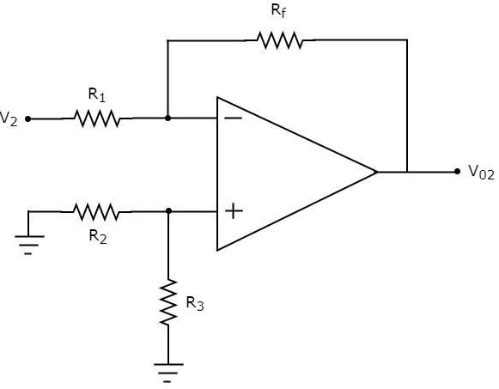
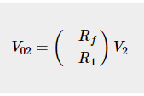

Step 2
In this step, let us find the output voltage, V02 by considering only V2 Similar to that in the above step, eliminate V1 by making it short circuit.
Step 3
In this step, we will obtain the output voltage V0 of the subtractor circuit by adding the output voltages obtained in Step1 and Step2. Mathematically, it can be written as
Prof. D. G. Lokhande Department of E & Tc Engg.

Slide 52
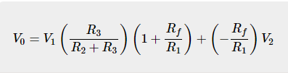



Rf=R1=R2=R3=R, then the output voltage V0 will be
Prof. D. G. Lokhande Department of E & Tc Engg.

Slide 53


Thank You!

